Slide 1

ICS 2303 Multimedia Systems
Lecture 2d: Multimedia Data Processing(Sound, Image/Video)

Slide 2
Areas of Application of Digital Technology
Computers
New telephone networks and capabilities e.g video conferencing etc
Digital television technology -e.g Interactive TV, Video o

Slide 3
Digital Technology Concepts
Digitization of information is an important step in processing data
Basics
Digital signals that could be assigned digital values
Digital computer technology
Digital signals
Binary representation
Encoded into ones and zeros

Slide 4
Advantages Digital Signals
Native language of the computer-Information can be processed by the computer
Control programmable services
Better quality due to being able to reconstruct exact digital patterns at the receiving end
Faster communication speeds are possible
Easy transmission of information over the Internet and other computer networks
Minimize loss of quality during transmission

Slide 5
Digital Signal
1 0 1 1 0 1 0 0
Signal Strength
Pulse
Time
Pulse Duration

Slide 6
Digitization of Information
Information need to be digitized for computer processing and the transmission of information
Convert into digital form for processing storage and transmission

Slide 7
Components of Information
Alphanumeric data
Image
Audio
Video

Slide 8
Digital Information Processing
Data
Digitized and Encoded
Digital
Transmission
Audio
Image
Video

Slide 9
Digitization Of Alphanumeric Data
Alphanumeric data is digitized using well established coding systems
Unicode
EBCDIC
ASCII
Etc
See notes on encoding schemes

Slide 10
Digitization Of Audio

Slide 11
Digitization Of Audio: Overview
Take samples of audio at pre-determined time intervals known as the sampling rate
Represent the sampled audio with digital signals
Pulse Amplitude Modulation (PAM)
Encode signals into binary code
Pulse Code Modulation (PCM) that incorporates PAM as well
Required for computer processing

Slide 12
Digitization of Audio: Pulse Amplitude Modulation (PAM)
Audio
9 8 7 6 7 9
Digital Signals must further be encoded into binary signals for computer processing and transmission.
Sampling Interval

Slide 13
Digitization and Encoding of Audio: Pulse Code Modulation (PCM)
PCM is a two step process
First the audio is sampled and represented by digital signals
The digital signals are then encoded in binary form
Assign 1 Q1. Define signal sampling and show how it is used to in processing audio data

Slide 14
Binary Encoding of Signals in Pulse Code Modulation (PCM)
PCM
9 8 7 6 5 6
1001 1000 0111 0110 0101 0110
The integer numbers have effectively been coded into zeros and ones. The ones and zeros now contain the audio information encoded in a form that could be processed by a computer.

Slide 15
Salient Points on the Digitization Of Audio
Sampling rate? and the number of bits? used for representing the samples will determine the quality of the audio
Quality is retained in transmission because only codes are transmitted
Audio can be recreated to the original quality by extracting the pattern from the digital code

Slide 16
Sampling Factors
Sampling interval determined by sampling frequency
Measured in Hz
Sampling depth
Measured in number of bits used to encode the sample
Sampling channels
Mono or stereo, for example 1 for mono and 2 for stereo
Assign: Distinguish between the two and illustrate it use and advantages

Slide 17
Sampling Example
CD quality audio
44 KHz
16 Bits
Stereo

Slide 18
Audio Quality, Bandwidth and Streaming

Slide 19
Factors Affecting Quality
Number of bits used for binary encoding. Example: 4 bits allow 16 amplitude variations to be represented. 2⁴=16
9 8 7 6 7 9
Sampling Interval

Slide 20
Effect of Sampling Frequency
Higher sampling frequency
Smaller sampling intervals, time between samples
Frequent sampling
Better quality because the audio pattern is captured better
Higher bandwidth required for transmission
Higher disk space required for storage

Slide 21
Computation of Bandwidth Requirement for Transmission
Problem:
Compute the audio streaming rate for a voice grade circuit given that the number of bits used in the sampling is 8
Background information
A voice grade circuit has a bandwidth of approximately 4000 Hz
General rule
For acceptable quality, the audio must be sampled at twice the frequency of the voice grade bandwidth

Slide 22
Reason for Sampling at Twice the Frequency
According to Nynguist Theorem
Two peaks in each cycle
Half of a cycle is above the datum line
The other half of the cycle is below the datum line
Therefore, sample the audio at twice the frequency rate

Slide 23
Example CD Sampling
Sampling in this case is done for higher quality
44 KHz
16-bits
Stereo

Slide 24
Problem Representation
8 bits are used enabling
256 amplitudes to
represent the human
voice which is considered
to be adequate.
79 68 57 46 57 79
1/8000 Seconds (8000 HZ twice the frequency of the voice
grade circuit)
or 2X4000 samples per second

Slide 25
Bandwidth Computation for Voice
Number of samples
8000 per second
Number of bits per sample
8
Bandwidth requirement
8X8000 bps = 64,000 bps
Approximately 64K bps
64K bps is the speed of a single ISDN (B) channel designed to carry voice

Slide 26
Bandwidth of Voice Circuits
Generally speaking, the bandwidth requirement for uncompressed voice circuit is 64 Kbps
An example is the ISDN – B channel that was originally intended to carry voice
Its bandwidth is 64 K bps

Slide 27
Examples in Audio Quality and Bandwidth Requirement
CD quality
44,100 Hz, 16 bit, Stereo
1376K bps
Radio quality
22,050 Hz, 8 bit, mono
176K bps
Telephone quality
11,025 Hz, 8bit, mono
88K bps

Slide 28
Audio Transmission In WWW
Audio streaming requires compression.
Web
Site
28-56K bps
Client
Receive audio using
Internet Explorer
and a plug-in to receive
the audio stream.
Real-time audio
broadcast support
using streaming
server module.

Slide 29
Delivery of Instruction Over the WWW
Audio/Video streaming.
Web
Site
28-56K bps
Client
Store streamed audio/
video using Windows Media.
Receive audio/video using
Internet Explorer and Media
Player.

Slide 30
Types of Multimedia Transmission
Unicasting
Multicasting
Broadcasting

Slide 31
Sampling Considerations In Communications
Digital audio transmission
Sender
Receiver
Adjust quality (sampling interval and bit
representation) to suit bandwidth availability.

Slide 32
Audio Files
Audio can be stored in different formats
Uncompressed or raw file format (wav)
Compressed format
Streaming format
Streamed audio is also compressed
It is also designed for real-time delivery of audio

Slide 33
Audio File Format
wav file format
Basic file format in audio storage or raw file
rm file format
Real audio’s streamed file format
Streamed file
wma file format
Microsoft’s audio streamed file format
Streamed file
mp3 file format
Compressed file
aac file format

Slide 34
Quality Retention in Digital Transmission

Slide 35
Quality Retention
Quality is retained in digital transmission because only the codes are transmitted
Quality is subject to some deterioration in analog transmission because the wave pattern is transmitted

Slide 36
Analog Audio Transmission
Audio Prior
to Transmission
Audio with
Interference
Transmission
Audio After Filtering

Slide 37
Passage of Analog Audio Over Analog Lines
Analog
Audio
Analog
Signals
Telephone
Analog
Audio
Analog
Signals
Telephone

Slide 38
Recreation of Audio from Analog Signals
A difficult task
Complex algorithms are used to filter noise etc. for better audio transmission

Slide 39
Signal Passage in Digital Audio Transmission
Encode
Audio
Recreate
Transmit
Decode
Audio

Slide 40
A Sample Digital Audio Transmission Path
Analog
Audio
Digital
Audio
DSL
Modem
Sound
Card
Digital
Network
Analog
Audio
Digital
Audio
DSL
Modem
Sound
Card

Slide 41
Sound Generation
Sound is recreated at destination
Using FM synthesis
Using wave table generation
Noise is not an issue in digital communication although it is an issue in digital transmission
The reason, once again, is due to the fact that only codes are transmitted in digital transmission

Slide 42
Better Sound Generation
Wave table generation provides better sound reproduction that FM synthesis

Slide 43
Digital Advantage in Audio Transmission
Only codes are transmitted
Original encoding is recreated
Original audio is reproduced
Again, sampling rate and number of bits used in each sample will determine the quality of audio transmitted

Slide 44
Digitized Signal Transmission Over Analog Lines
Sampled Signals
Encode
Audio
Recreate
Transmit
Decode
Audio

Slide 45
Sample Digital Audio Transmission Path Over Analog Lines
Analog
Audio
Digital
Audio
Modem
Sound
Card
Analog
PSN
Analog
Audio
Digital
Audio
Modem
Sound
Card

Slide 46
Audio Transmission In WWW
Audio stream over analog/digital line.
Web
Site
Client
Real-time audio
broadcast support
using Windows Media
streaming server module.
Receive audio using
Internet Explorer
and Windows Media Player.

Slide 47
Analog to Digital Converter
A to D and D to A converter
The chip that is responsible for this conversion is known as the DSP (Digital Signal Processor) chip
It is used in sound cards, modems etc. wherever there is a need for A to D and D to A conversion
The mass use of this chip in various devices has led to a drastic drop in the price of the chip and the devices

Slide 48
Digital Signal Processor (DSP)
DSP
Digital
Analog

Slide 49
Digitization Of Image

Slide 50
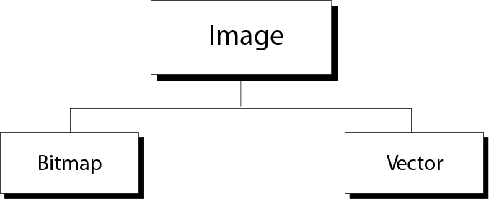
Image representation methods

Slide 51
Bitmap Graphic
A image is divided into a matrix of pixels, where each pixel is a small dot.
More pixels ⇒
Better representation of image ⇒
Better resolution ⇒
More memory
Each pixel is assigned a bit pattern. The size and the value of the pattern depend on the image.

Slide 52
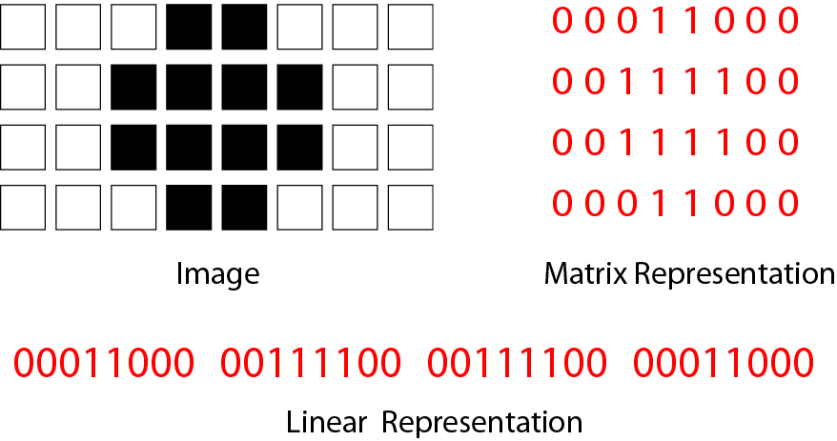
Figure 2-7
Bitmap graphic method of a
black-and-white image

Slide 53
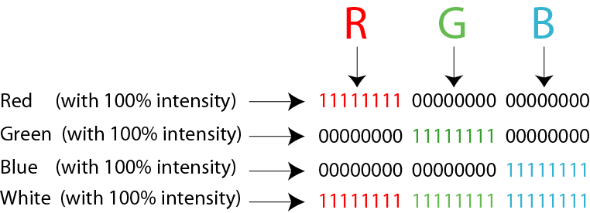
Color image
Each pixel is decomposed into 3 primary colors: red, green and blue. (RGB)
The intensity of each color is measured, and a bit pattern (8 bits) is assigned.
Representation of color pixels
Figure 2-8

Slide 54
Resolution
The term is most often used to describe monitors, printers, and bit-mapped graphic images.
Dot-matrix and laser printers, the resolution indicates the number of dots per inch. For example, a 300-dpi (dots per inch) printer is one that is capable of printing 300 distinct dots in a line 1 inch long. This means it can print 90,000 dots per square inch.
Graphics monitors, the screen resolution signifies the number of dots (pixels) on the entire screen. For example, a 640-by-480 pixel screen is capable of displaying 640 distinct dots on each of 480 lines, or about 300,000 pixels.

Slide 55
Vector Graphic
A image is decomposed into a combination of curves and lines.
Each curve or line is represented by a mathematical formula.

Slide 56
Audio
Audio is a representation of sound or music.
Audio is by nature analog data.
It is continuous, not discrete.
Audio is converted to digital data and stored in bit patterns.
Sampling
Quantization
Coding
Stored

Slide 57
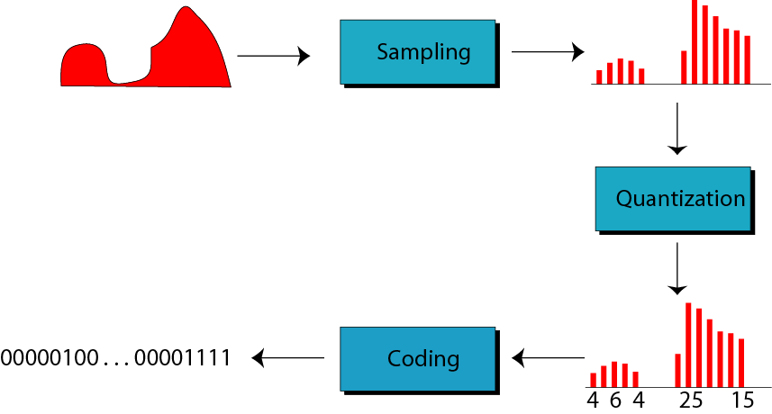
Figure 2-9
Audio representation

Slide 58
Video
Video is a representation of images (frames) in time.
A movie is a series of frames shown one after another to create the illusion of motion.
Today video is normally compressed.

Slide 59
Image Digitization
Image can be of the form black and white, gray scales, color
Factors that influence the digitization of image are as follows
Resolution measured in pixels
Color depth expressed in number of color variations

Slide 60
Digitization Of Image: Overview
Pixel
Horizontal Resolution
Vertical Resolution

Slide 61
Digitization of the Letter L
Number of bits
determine the
amount of
information that could
be stored.

Slide 62
Digitization Of Image: The Process
Divide the image into a grid of pixels that may be considered as the sampling points of the image
Digitize information on each pixel
Store and transmit

Slide 63
Resolution
Horizontal resolution
Number of horizontal pixels
Vertical resolution
Number of vertical pixels
Image resolution
Horizontal by vertical resolution
Ex: 640 by 480

Slide 64
Digitization of Black and White Image
White
A pixel lit represents a 1
Black
A pixel not lit represents a 0
Storage required per pixel
1 bit
Storage required for 640 by 480 resolution image
640 times 480 bits = 307,200 bits = 38.4K Bytes

Slide 65
Digitization of Image Using Gray Scales
A pixel may take a value between 0 and 15 for 16 gray scales
A gray scale of 3 can be coded as 0011 and the others similarly using this 4 digit code
The bandwidth requirement for the transmission of a 640X480 image in this case is as follows:
640X480X4 = 153.5K Bytes

Slide 66
Digitization of Color Image
Image coding
Each pixel may take a value between 0 and 255 if 256 colors are to be represented
Storage requirement
Digitizing of images requires substantial number of bytes and hence large storage space for processing
Bandwidth requirement
Higher bandwidths are required to transmit color images

Slide 67
Bandwidth Computation for Image with 256 Colors
Resolution is 640X480
8 bits are required to represent 256 colors
bandwidth requirement for the transmission of one image is as follows:
640X480X8 = 307.2K Bytes

Slide 68
The Effect of Color Depth and Resolution
Compare VGA, SVGA and XGA
XGA provides the highest resolution
Practical implication
More colors less resolution if bandwidth or storage is the limiting concern
Example
256 colors at lower resolution
16 colors at higher resolution
Rule
Higher the resolution the lower the number of colors available in general given the resource constraints such as bandwidth constraints

Slide 69
Factors Affecting Bandwidth Requirement in Image Transmission
The higher the resolution, the higher the bandwidth requirement for transmission
The higher the color representation, also known as color depth, higher the bandwidth requirement
For true color, 24 (32) bits are required to represent each pixel
The file sizes in raw image capture can thus become very large

Slide 70
Compression of Digitized Images

Slide 71
Compression of Digitized Images
Compression is required to reduce the size of the image file
Large blocks of unchanged data in an image (background) offers an opportunity to compress the image
Image files are almost always compressed

Slide 72
A Few Compression Formats
GIF
JPEG
MIC (Microsoft Image Composer)
PCD (KODAK) - Used by Corel
Uncompressed file exist in the form of bit mapped file with the extension of .BMP

Slide 73
Image File Format Extensions
File formats often represent the compression procedure being used such as jpg representing the jpeg compression technique
Examples:
Bmp – uncompressed file format
Gif
jpg
pcd
tiff
pcx

Slide 74
Loss-less Compression and Others
Some compression formats offer loss-free compression of the image
Others sacrifice minimal loss for the sake of reduced storage and bandwidth requirements
Fortunately, the loss is not easily detected by the naked eye

Slide 75
Image Transmission Considerations
Adjust image to suit available bandwidth.
Sender
Receiver
Adjustable features are as follows.
- Resolution
- Color depth
Adjusting the size also reduces the bandwidth
requirement because of a corresponding reduction
in the number of pixels required to represent
the image.

Slide 76
A Peek At Data Compression
0 0 0 0 0 0 0 0 0 0 0 - - - - - -0 1 1 1 1 1 11 …... 0
THE ABOVE CAN BE COMPRESSED INTO = #9000$0#
9000 bits are compressed into 8 characters that require approximately 64 bits for transmission
9000 ZEROS ARE CODED INTO #900$0#
#600$1#
600
NUMBER COUNT
INTERPRET WITHIN THE # SIGN
1
CHARACTER BEING
TRANSMITTED

Slide 77
Compression Result
In the previous example, 9000 bits are compressed into 8 characters
If 10 bits are used on the average for transmitting each character, the 9000 bits of information is now compressed into 80 bits for transmission

Slide 78
Modem Implication in Image Transmission
Modems also compress the data stream to achieve higher transmission speeds
Because of the fact that the images are already compressed, the full speed benefit may not be realized when images are transmitted over a modem connection
An already compressed image file does not, for instance, offer itself well to further compression in the modem

Slide 79
Module
Digitization Of Video

Slide 80
Digitization of Video
Digitization of video is an extension of the process of digitizing an image
It amounts to the transmission of certain number of still images known as frames per second
Obviously, digitized video requires higher bandwidth for transmission and more space for storage

Slide 81
Frame Rate
30 frames of images per second, in general, defines continuos motion
In communications, 25 frames per second is considered to be continuous motion
15 frames per second is currently used in video conferencing over digital lines for acceptable reception of video
It is also possible to engage in video conferencing at a frame rate of 5 frames per second

Slide 82
Computation of Bandwidth for Raw Transmission of Video
Image resolution is 640X480
Number of colors is 256 (8 bit)
Acceptable reception requires 15 frames per second
Therefore, the bandwidth for the raw transmission is as follows:
640X480X8X15 = 36.86M bps = 4.6M Bps

Slide 83
Compression Standards Used in the Digitization of Video
MPEG 1, MPEG 2, MPEG 3 and MPEG 4
Windows Media Video
Real Media
Indio
QuickTime
ActiveMovie
AVI

Slide 84
Streaming Formats for Video
Various streaming formats are supported by different vendors
RealVideo
Microsoft’s streaming format
wma (Windows Media Audio)
wmv (Windows Media Video)
Active Streaming Format (ASF)
Apple’s QuickTime format
Etc.

Slide 85
Overview of Video Transmission in Video Conferencing
Minimum speed
3 to 5 frames per second
Acceptable speed
15 frames per second
Transmission techniques
Data is compressed
Only changes to the frame are transmitted

Slide 86
Bandwidth Optimization in Video Conferencing
Minimize Windows for maximum efficiency
Transmit less number of pixels in minimized form
Decrease the resolution
Has the same effect as above
Decrease the number of colors displayed

Slide 87
Communication Links for Video Conferencing
Possible on analog lines using 56,000 bps transmission speed but not desirable
Digital lines are preferred and the guidelines are as follows:
Possible at 128k bps using ISDN lines
Acceptable at 384k bps
1M bps and above offer good quality video transmission

Slide 88
ISDN Line Suitability
ISDN B channels can be assigned on a dynamic basis depending on the bandwidth requirement at any point in time during video conferencing

Slide 89
Video Conferencing Products
Intel ProShare
CU-See Me
Picturetel
C-phone
etc.

Slide 90
End of Lecture

